Slide 1


Entity Framework on Asp.net
In this presentation, we will learn about the concept of Entity Framework in Asp.net and examine its key components and usage.
By Amirshayan Jalili

Slide 2

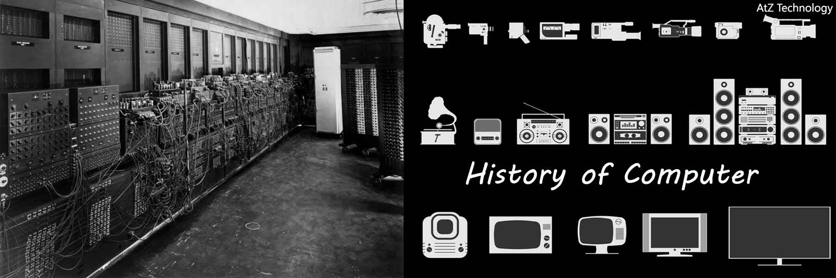
Before introducing Entity Framework, Microsoft introduced RDO, ADO and ADO.NET technologies . With the expansion of object orientation and the need of programmers to convert data into objects, Microsoft developed ADO.NET technology and Linq facilities. And then it introduced Entity Framework to better interact with object orientation.
History

Slide 3
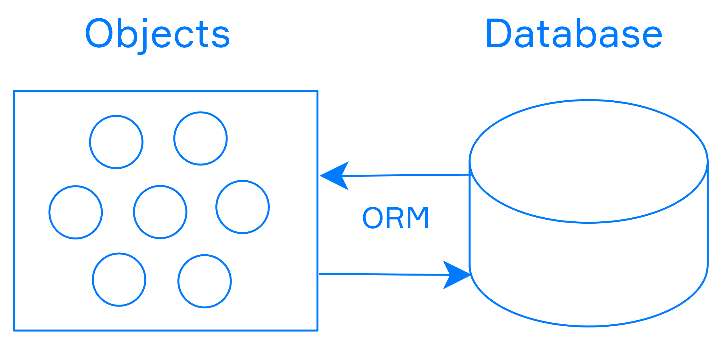
ORM Or Object Relational Mapping
the concept of ORM or Object Relational Mapping . ORM is a tool that can be used to process database tables and map them to an object format that is more readable in coding. In coding, instead of working directly with database tables, we work on objects. These objects are called entities .

Slide 4
Concept of Entity Framework
1
Simple and efficient
2
Database interaction
3
Facilitate CRUD operations
Entity Framework is a complete and powerful ORM (Object-Relational Mapping) that frees developers from the need to write SQL code directly in Asp.net applications.
Entity Framework helps the interaction between objects and tables in the database by using the Entity Model.
Entity Framework performs all Create, Read, Update and Delete operations for us easily and with minimal codes.

Slide 5
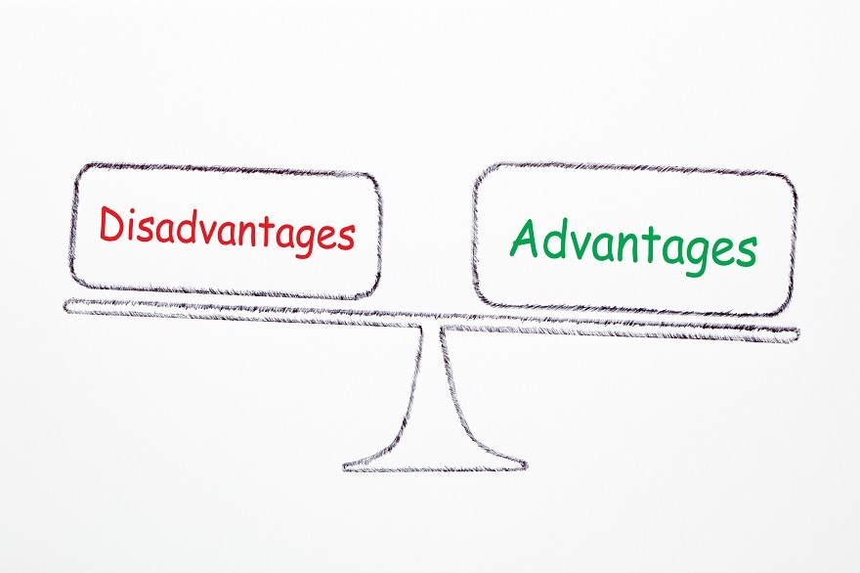
Advantages
1
3
Access to data
Inheritance
Accessing data in this framework is very simple and allows you to create the conceptual model needed for business.
, there is rich and good inheritance support for tables for hierarchy, subclasses and concrete types .
2
EF
EF allows you to manage many-to-many relationships without multiple JOINs .

Slide 6
Disadvantages
1
Low weight
2
Using Designer
Despite the addition of many features to version 4 of this framework, this tool is still relative to ORM The popular ones have some shortcomings
Due to the use of Designer , it is not possible to have much control over the generated code, which of course has been improved to some extent by using Partial classes.

Slide 7

What is Asp.net?
Asp.net is a web application development framework created by Microsoft. By using Asp.net, displaying programs on the web will be safe and highly functional.

Slide 8

Coding structure and use From Entity Framework
1
Connect to the database
To use Entity Framework, we must first connect to the database and establish a connection.
Create an entity model
2
Then we need to create our entity model and connect it to the database.
3
Using LINQ
Using the LINQ query language, we can run more complex queries on the entity model.

Slide 9

Detailed examination of Entity Framework on Asp.net
Model First
Database First
Code First
In this method, the entity model is created first and then the database is created based on this model.
In this method, first the database is created and then the entity model is built based on the format of the database tables.
In this method, first the entity model is defined and then the database is built based on this model.

Slide 10

query _
LINQ on Entity Framework
Using the LINQ query language in the Entity Framework, we can send complex queries to the database and get the results in a compact and comprehensible manner.

Slide 11
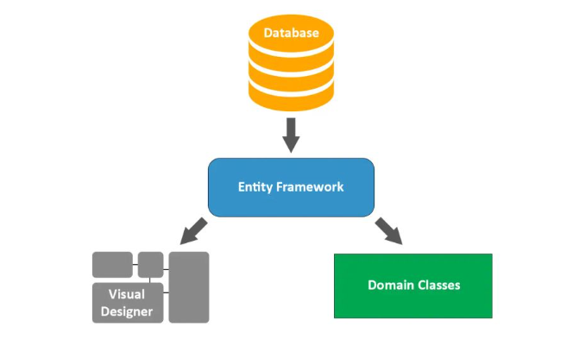
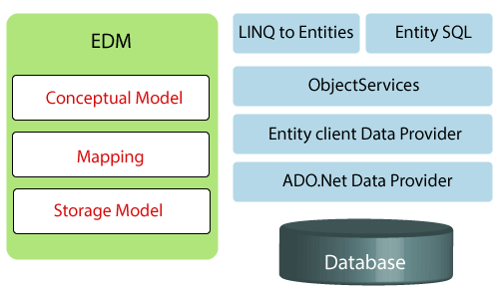
Entity Framework architecture
Key components
Entity Framework includes strengths such as DbContext , DbSet and Code First Migration are very useful in developing Asp.net applications.
Entity Framework includes components of such as
Entity Data Model , Object Services and LINQ to Entities play an important role in database performance and operations.

Slide 12

References
1
1 learn.microsoft.com
2 stackoverflow.com
2
3 stackoverflow.com
3
4 entityframeworktutorial.net
4

